Slide 1

Revolutionizing Aquaculture: Aquaprosper Africa
Presented by Sir. Rawllince Okello
2nd September 2025

Slide 2
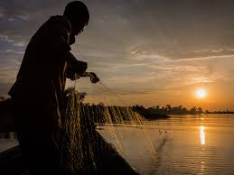
Turning the Tide: Empowering 3 Million Fish Farmers on Lake Victoria"
Did you know? Over 3 million people rely on Lake Victoria for their livelihood, yet over 60% of fish farmers struggle with poor yields, lack of support, and limited market access.

Slide 3
The Silent Problem: Addressing Fish Farming in Lake Victoria
Fish farming is a multi-billion-dollar industry, but recurring disease outbreaks ,pollution of the lake and frequent droughts among others pose a significant threat to profitability and sustainability. These threats can lead to:
Overfishing
Lack and insufficiency
Decline in fish stocks and population
Limited access to quality feed , fingerlings and training
Poor storages
Market Access
Post-hervest losses up to 30% due to poor stage methods and facilities
Farmers are often exploited by middlemen due to lack of direct market access

Slide 4
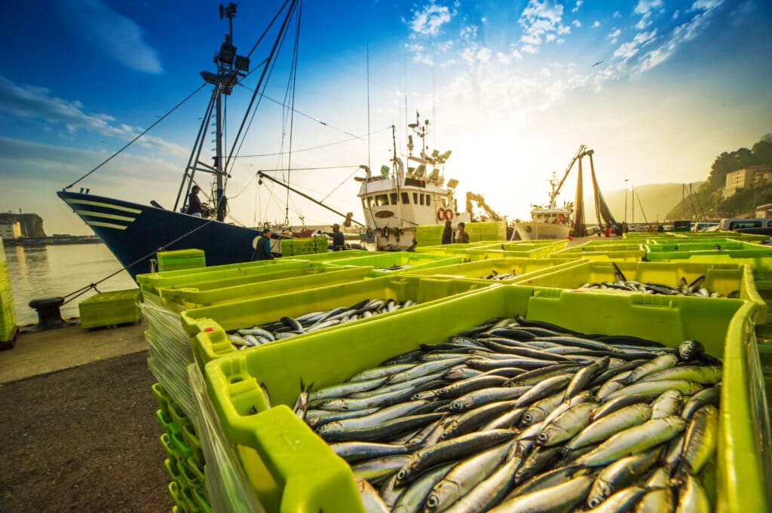
Solution
Aqua Prosper Africa provides
An integrated platform for fish farmers:
Training and extension services(best practices)
Cold storage and processing solutions
Digital market place connecting farmers
directly to buyers
Acee to affordable high-quality fingerlings

Slide 5
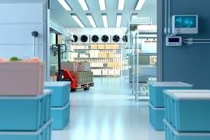
PRODUCTS:
Mobile app and platform: advisory services, market prices, Training videos
Farmers support centers: on the ground supply and training hubs
Smart cold storage: solar powered storage reducing post harvest loss.
Market Access: Connecting farmers with restaurants, exporters and local buyers

Slide 6
Target Market
Restaurants, hotels, and fish processing companies needing consistent supply
Small-scale fish farmers around Lake Victoria (Kenya, Uganda, Tanzania
Export markets demanding sustainable fish.
Domestic markets within the country

Slide 7
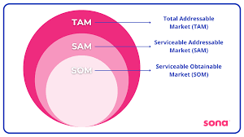
Market size
Aqua prosper: Estimated market
3 million + small scale fish farmers in lake Victoria region
Annual fish trade value in East Africa: 600 million dollars
Export demand for tilapia and Nile Perch is rising by 7% annually.

Slide 8

Competitive Advantage
End-to-end solution
(training, inputs, storage, market access).
Technology-driven
(mobile marketplace + advisory AI).
Sustainability focus
(solar storage, restocking programs).
Farmer-first approach
(profit-sharing and fair trade).

Slide 9


Traction and Roadmap
Pilot success: 500 farmers onboarded in Kisumu, Kenya.
Partnerships: Local cooperatives + Ministry of Fisheries.
Next 12 months: Scale to 5,000 farmers, launch 3 farmer hubs.
3-year goal: Reach 100,000 farmers across Lake Victoria region.
From marine biologists and veterinary experts to data scientists and operational specialists, our team is united by a passion for sustainable aquaculture and a commitment to our clients' success.

Slide 10
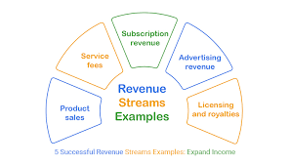
Business / Revenue Model
Revenue streams:
Commission on market sales
Subscription for advisory and training services
Input sales (Feeds and fingerlings)
Cold storage rental fees
This growth will be fueled by strategic partnerships, increased market penetration, and the continuous innovation of our AquaHeal solutions.

Slide 11
Competitors
Local fish cooperatives
NGOs offering limited support
Importers of frozen fish
Weakness of competitors: Fragmented , unsustainable no integral solution.

Slide 12
Go-to-market strategy
Farmer Cooperatives: Partner for mass onboarding
Local hubs: set up demo farms and training centers
Mobile-First Approach: App and sms services in local languages
Government and NGO partnerships: for credibility and reach

Slide 13
Our ask
Funding is needed: $2.5 M
$1M for technology development and scaling
$1M for cold storage infrastructure
$0.5M for training and farmer outreach
Support needed with government NGOs and buyers

Slide 14

The Team
CEO & Founder-Fisheries expert with 10+ years in aquaculture
CTO- Tech leader with experience in Agri-Tech platforms
Operations Lead- Former NGO project manager in East Africa
Advisory- Industry experts in Aquaculture logistics and trade.

